Slide 1
Managing
The New Workforce
------------------------------------------
It’s A Whole New Ball Game!
Presenter, Martha N. Bryan
425-337-1838 Office * * * 425-338-4509 Cell
Bryan & Bryan Associates
marthabryan@bryanandbryanassoc.com

Slide 2
Managing the New Workforce . . . It’s Changing
Old Versus New
"I have been in this business 36 years. I've learned a lot . . . and most of it doesn't apply anymore.“
~ Charles Exley, CEO IBM Corporation

Slide 3
Appreciating Many Aspects of Diversity
Generational differences may influence behavior; however, this does not mean that generational differences determine adult interactions. There are a host of other variables which come into play that impact behavior and outcomes.
Generational differences represent only one of these factors.
  Points to Keep in Mind!
  Common experiences of each generation
  frequently define their assumptions and perspectives.
    BUT
  Never generalize from a few to the whole
  . . . there are ALWAYS exceptions.

Slide 4
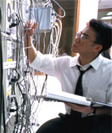
Why Are Things Different?
In the past, relatively stable organizational model for career advancement.
Today, organizations come in many sizes, types, and shapes.
Career paths vary (average 25-year-old is expected to experience anywhere from five to 5-8 careers in lifetime).
Work-life expectations have changed with the generations.

Slide 5
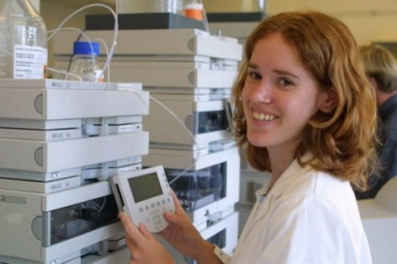
Why Shift Our Leadership Approach?
Today Four Generations In Workplace
Today Technology Links People
Business Complexity (Need Collective Resources Of All)
Failure To Satisfy Customers
Employees Want To Know Why
Employees Want Ownership In Their Work
People Closest To The Work Know Best How To Improve It

Slide 6
Managing Today’s Employees
"Old Story" Managers . . . Their style of leading
“New Story" Managers . . . How they will need to change

Slide 7
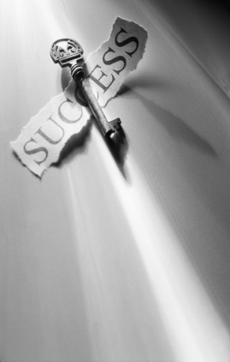
Attributes Of Flexible Supervision
Their supervisory style is not fixed.
Their leadership style is varied to meet follower’s needs.
They depend more on their personal power.
They know when and how to make personal policy exceptions.
They match individuals to a team or individual to an assignment.
They balance concern for tasks and concern for people.
They understand the elements of trust and work to gain it.
Authors Zempke, Raines, Filipczak

Slide 8

Working with all Generations
Accommodate individual differences.
Create workplace choices for all the generations.
Use a situational management style.
Respect competence and initiative.
Nourish retention and mentor.
Focus on outcomes.
"Managing multi-generational workforces is an art in itself. Young workers want to make a quick impact, the middle generation needs to believe in the mission, and older employees don't like ambivalence. Your move."
Can You Manage Different Generations Harvard Business School

Slide 9
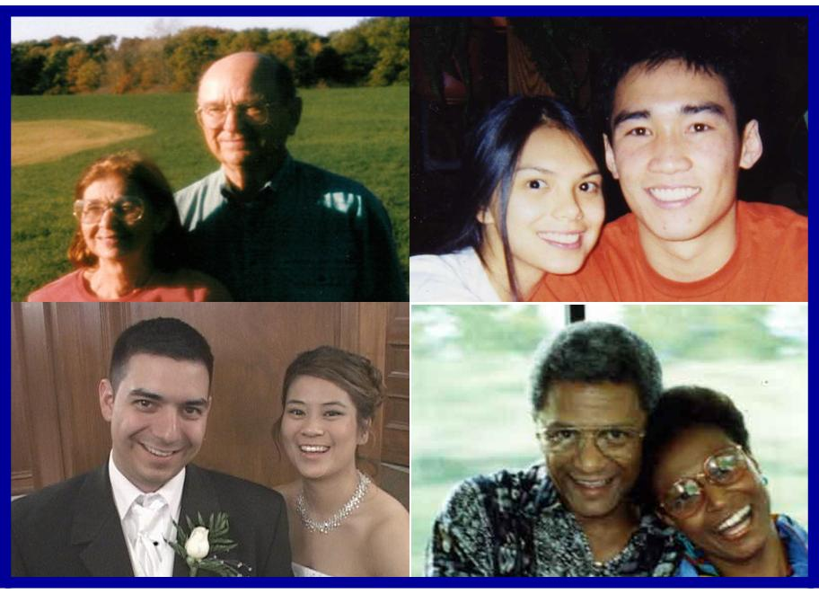
How Managers Can Embrace & Respect All Employees
Don’t allow your biases to affect the way you conduct yourself at work.
Take a genuine interest and find common ground with someone with a different backgrounds.
Bring together diverse groups for innovation. You’ll get a better product.
Respect religious holidays for employees of that particular religion.
Strategize with someone with a different background who shares the same goals as you.
Respect what employees bring to the workplace.
Find out about employee’s skills, knowledge, and experiences.
Invite someone with a diverse background to lunch or change your table.
Avoid language that demeans a particular group of individuals.
Let skills, abilities, knowledge and results be the factors involved
in your hiring / promotion decisions.

Slide 10

Generational Work Performance Expectations
Every employee should be held to the same standard.
No adaptation should be made that compromises the integrity of the job or diminishes the effectiveness of your organization to carry out its mission.
All employees should comply with policies and procedures set forth by their organization.

Slide 11
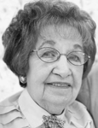
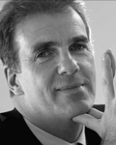
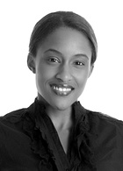
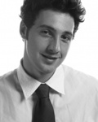
Being Successful With The New Workforce
Your Suggestions!!!
+
+
+

Slide 12

Being Successful With The New Workforce (slide 1 of 2)
DO be aware of your own cultural biases.
DO change your world view.
DO take time to learn about the culture of your employees.
DON’T give in to stereotypes.
DO respect your employee, even if you don't understand their way of doing things.
DO take the time to understand the "why" behind your employee's actions.
DON’T shield yourself from people from different cultures.
DON’T condemn different viewpoints as always wrong.
DON’T think you can do it alone. Ask for help.

Slide 13
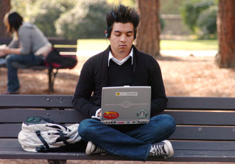
Being Successful With All The Workforce (slide 2 of 2)
DO solicit feedback on your employees' challenges and frustrations.
DO work harder on understanding culture-based causes of conflict.
DO anticipate scenarios in which perspectives may collide.
DON’T be rigid on how job is to be done. (Focus on the goal and outcomes – not
how the tasks gets done.)
DO listen to your team. (Collaborate on creative solutions.)
DON’T overreact to negative feedback. (It's not always an indictment on your management style or personal beliefs.)
DO remember, the workplace is not one big melting pot. (It is individuals with
varying viewpoints, which can benefit the workplace.)

Slide 14
Younger Workers
* * * * * * * * * * * * * * * * * * * * * * *
Their Strengths
&
Their Needs

Slide 15

A Focus On Younger Workers . . .
80,000,000 Strong
Their Strengths . . .
Multi-Taskers
Technologically Savvy
Purpose & Achievement-Oriented
Team Players & Collaborative
Resourceful
Innovative / Change Agents
Embraces Diversity
Civic-Minded
Optimistic
The Largest Generation In Today’s Workplace
Younger
Workers

Slide 16
Millennials Prefer Workplaces That . . . (1 of 3 slides)
Lets them make it on their own
Allows them to multitask (it prevents boredom)
Allows them to collaborate & problem solve with others -- encourages networking
Doesn’t take away their technology -- takes advantage of their technology savvy
Focuses on outcomes
Challenges them while teaching them new things
Surrounds them with impeccably honest, trustworthy, ethical & open
bosses, peers, and employees
Under-promises & over-delivers

Slide 17
Millennials Prefer Workplaces That . . . (2 of 3 slides)
Are approachable, responsive & present
Listen to them & doesn’t ignore their thoughts
Has an open flow of information
Builds relationships with them
Engages with them
Demonstrates interest in them & their success
Makes them feel like superstars
Tells them how they are doing
Focuses on their strengths
Focuses on the positive & frequent reinforcement
Gives them trophies

Slide 18

Millennials Prefer Workplaces That . . . (3 of 3 slides)
Offers flexibility (i.e., flexible & seasonal hours, work from home)
Plugs in to their parents (they are part of the package)
Communicates their way (blogs, text, twitter, instant messaging, etc.)
Limits the long sit-down meetings
Gets the work done with ease & speed
Lets employees give back to the community
Allows for work-life balance
Instills a fun-centered workplace
Entertains them
These Millennials Are Here To Stay!!!

Slide 19
Older Workers
* * * * * * * * * * * * * * * * * * * * *
Their Strengths
&
Their Needs

Slide 20

A Focus On Older Workers . . .
Their Strengths . . .
Stability, Punctual & Disciplined
High Work Ethic - Pride In A Job Well Done
Enhanced Knowledge, Wisdom & Confidence
Organized & Efficient
Writing & Problem Solving
Mature - Not Easily Rattled
Professional & Patient
Knows When, Where & How To Communicate
Great Loyalty To The Organization
Older
Workers

Slide 21
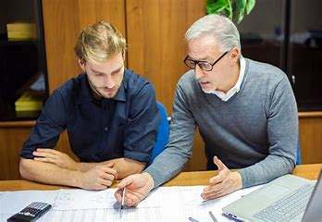
Older Workers Prefer Workplaces That . . . (1 of 3 slides)
Desires To Know Their Employees (Their History, Their Challenges
& Their Work Preferences . . .)
Promotes & Supports Continuous Learning
Offers Opportunities For Challenge & Meaningful Work
Offers Opportunities To Make A Difference
Provides Job Security & Predictability
Provides Flexible Benefit Packages & Work Arrangements
Supports A Balanced Work / Life Approach.
Creates Constructive Workplace Relationships
Is Concerned About employee’s Health & Well Being
Models An Open, Contribution-Based Environment
Aging Workers Are One Of Your Most Valuable Resources. Manage Them Well.

Slide 22
Older Workers Prefer Workplaces . . . (2 of 3 slides)
Provides An Environments Where Opinions Are Valued
Where Managers & Supervisors Are Skilled In People Management
Where Bosses Become Their Colleague / Their Partner
Values The Employee’s Strength, And Shows It (Validates Them)
Creates Mentoring Positions (Lets Them Mentor New Employees)
Are Not Arrogant Or Dismissive
Is Clear About Expectations With Respect To Outcomes & Participation
Elicits Feedback (Values Employees’ Lifetime Experiences)
Are Not Intimated By Employee’s Age
Have Bosses Who Can Find Commonality

Slide 23
Older Workers Prefer Workplaces That . . . (3 Of 3 Slides)
Bosses Debate With Employees & Then Welcomes The Best Ideas
Through Words & Action, Shows Care For Employees
Asks Them For Help (Can You Show Me . . .)
Makes Changes When Necessary, But Respects Tradition
Handles Conflicts Openly
Works Together For A Win-win Solution
When Needed, Becomes “The Boss”
Communicates Frequently & Transparently
Focuses On The Future & Outcomes

Slide 24

The Challenge
"Managing multi-generational workforces is an art in itself. Young workers want to make a quick impact, the middle generation needs to believe in the mission, and older employees don't like ambivalence. Your move."
The Benefit
Information flows in all directions in a learning organization. The most successful leaders find a way to let every generation be heard. They recognize that no one has all the answers. This appreciation allows each group to contribute and be a part of the growth of an organization.
Can You Manage Different Generations
Harvard Business School

Slide 25
Remaining In Control & Being Productive
When The Pressure Is On

Slide 26
Stress is . . .
Our internal response to the outside world.
* * * * * * * * * * * * * * * * * * * * * * * * * * * * * *
Stress originates . . . not out there,
But . . . Only in our mind.
Our Thinking . . . Makes it so!

Slide 27
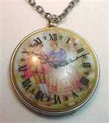
Characteristics Of Those Who Are Best Able To . . .
Handle Stressful Situations & Relationships
High Self-esteem (Sense Of Worth)
Feel They Can Control World Around Them
Are Challenged By Change
Are Committed & Intensely Involved In What They Do
Regard Challenge As An Opportunity To Grow
“The greatest weapon against stress is our ability to choose one thought over another.”
~ William James

Slide 28

Keeping Cool, Calm, and Collected When the Pressure Is On
  Have "escape routes.“
Remind yourself of your good qualities.
Talk to yourself.
Set realistic goals and expectations.
Take care of number one.
Establish quiet time.
Accept change.
Focus on areas you can control.
Negotiate and re-engineer pressure situations.
  Learn how to spot your stress warning signals.
  Stay informed about what is happening.
(slide 1 of 3)

Slide 29

Keeping Cool, Calm & Collected when The Pressure is On
  Keep current in your field.
  Have a plan "B".
  Be a problem solver.
  Use weekends as a change of pace.
  Everyday do something you really enjoy.
  Have an optimistic view of the world . . . focus on the positive.
  Be flexible in your attitudes . . . you may not know the full story.
  Anticipate change by constantly updating your skills.
  Make friends with non-worriers.
  Learn from those who are best able to manage stress.
(slide 2 of 3)

Slide 30

Keeping Cool, Calm & Collected When the Pressure Is On
Ask a colleague to let you know when you appear to be stressed.
Maintain your network and support groups.
Have a reward system.
Balance your life.
Go with the flow.
Learn to say "no.“
Have a positive mental attitude.
Maintain sensible perspective and a sense of humor.
Warm up to your job or find a new one.
(slide 3 of 3)

Slide 31
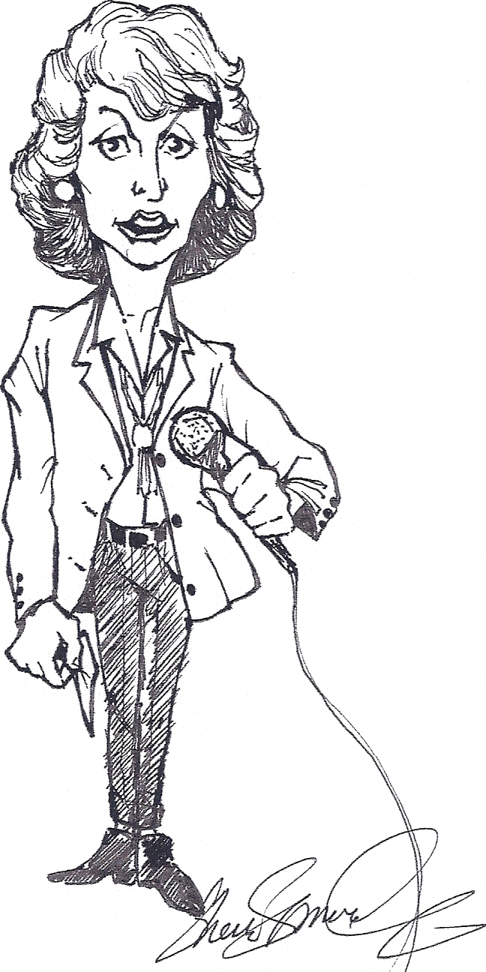
Make Managing Others
A Wild & Fun Ride
For Both You & Your Staff!!!
The End
* * * * * * * *
Thank you
Martha N. Bryan, Presenter
425-337-1838 Office * * * 425-330-8418 Cell
marthabryan@bryanandbryanassoc.com
Notes:
31

